Slide 1

NEWS SATIRE DETECTOR
capstone project standup
08/31/20
Gabriela Tanumihardja

Slide 2
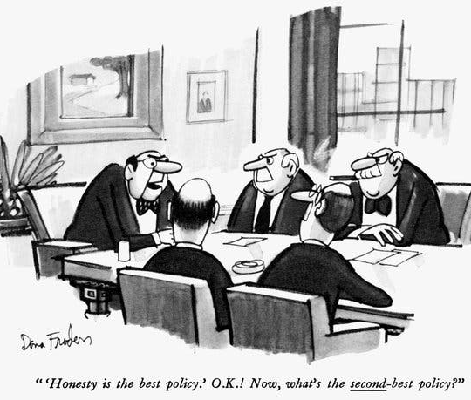
All Generalizations are Wrong, Including This One…
News Satire:
Designed to make commentaries on various topics and their vices and errors through humour
Uses sarcasms, ironies, parodies, and exaggerations
NOT intended to mislead
Often mistaken as legitimate news articles…

Slide 3
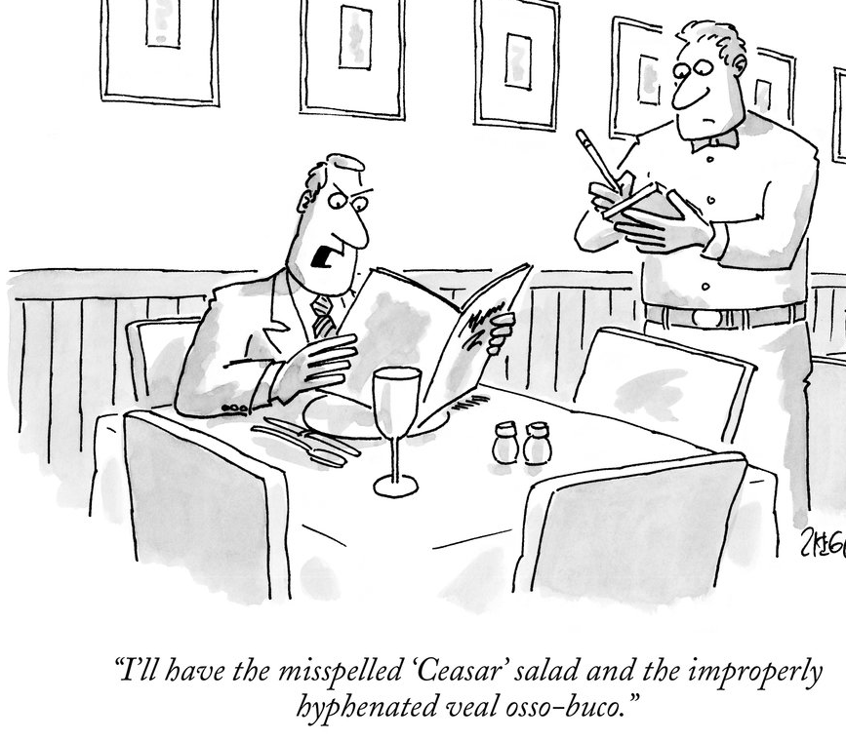




Data Collection
Satirical and Legitimate News:
Scraped from four news sources
Headlines, topic, and published date
Data scraped using Selenium and BeatifulSoup packages
BEFORE CLEANING
55,925 headlines
Published between 1993 – 2020
59% legitimate news, 41% satirical news

Slide 4
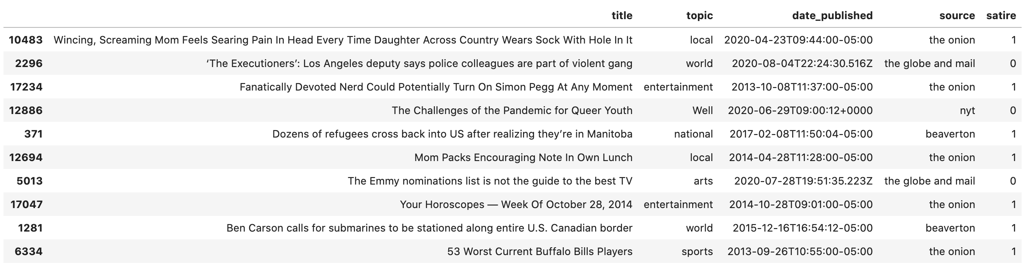
Data Description
Features
Target

Slide 5
Cleaning and Preliminary Modelling
CLEANING AND EDA
PRELIMINARY MODELLING
Removed duplicate entries
Removed entries with null values
Identified some titles that may skew the predictions
e.g. ‘Onion’ and ‘Horoscope’
Count vectorizers & TF-IDF
Logistic Regression
88% training / 83% validation accuracy
KNN
Performed with scaling and PCA
85% training / 70% validation accuracy
SVM (kernel = linear and rbf)
Linear = 84% training / 81% validation accuracy
RBF = 92% training / 83% validation accuracy
Decision tree
AFTER CLEANING
46,098 headlines
50% legitimate news, 50% satirical news

Slide 6
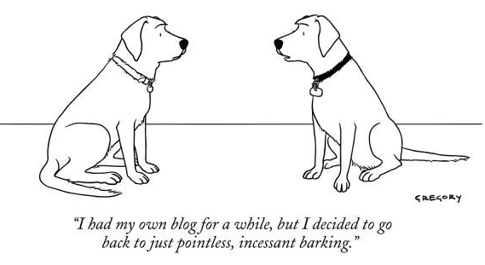
What’s Next?
Plans for the next 2 weeks:
Finesse dataset – replace common terms and add layers of stratification
Re-run models – logit, KNN, decision tree, SVM
Fit a random forest model
Hyperparameter optimization – SVM is showing potential
Build and fit deep learning models using TensorFlow

